Slide 1
Productive Browsing
Ali Haisam Muhammad Rafid | 1405013
Md. Toufikuzzaman | 1405015

Slide 2
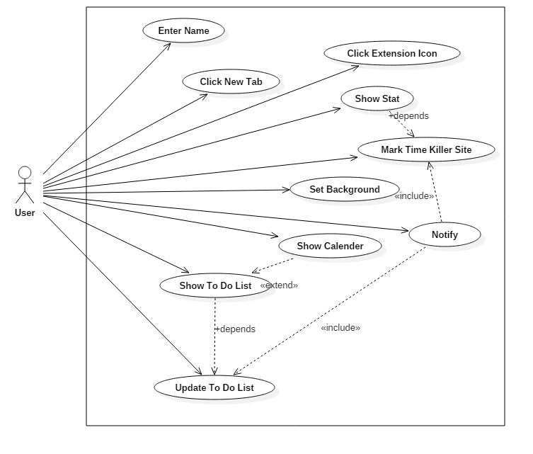
Use Case Diagram

Slide 3
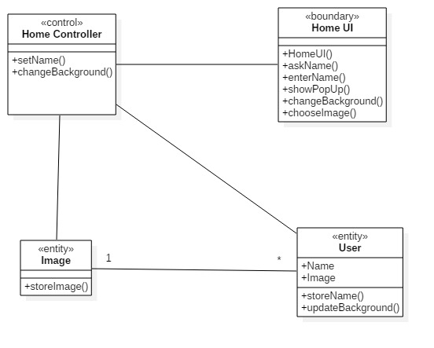
Class Diagram: Enter Name Click New Tab Set Background Click Extension Icon

Slide 4
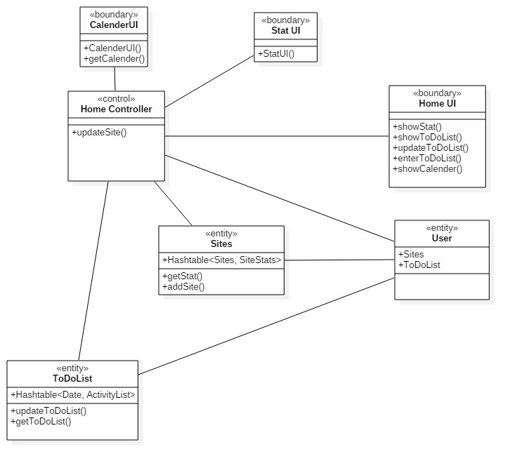
Class Diagram: Show Stat Show To Do List Update To Do List Show Calendar

Slide 5
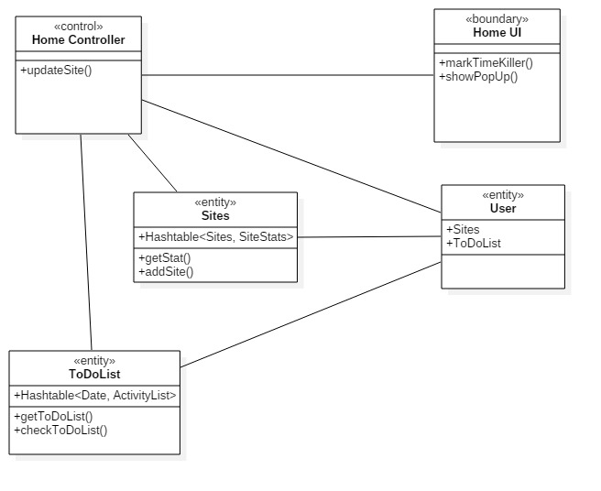
Class Diagram: Mark Time Killer Notify

Slide 6
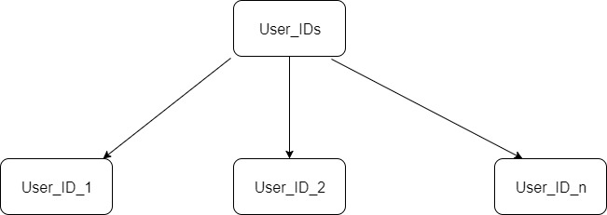
Database Tree

Slide 7
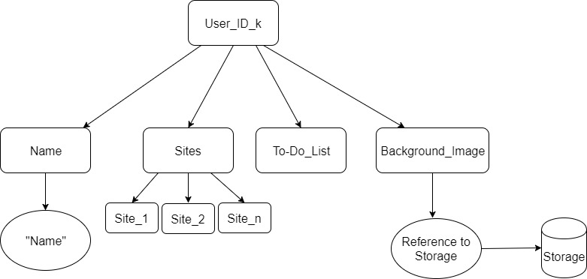
Database Tree

Slide 8
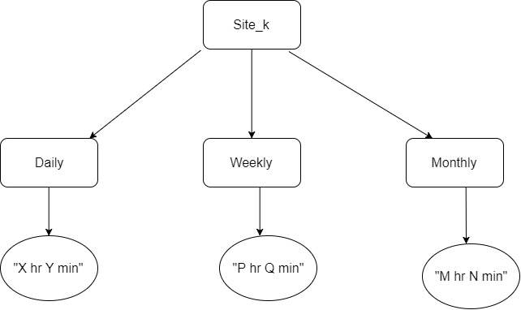
Database Tree

Slide 9

Database Tree

Slide 10
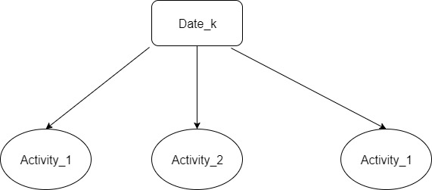
Database Tree

Slide 11
Thank You

